Slide 1

Function Size Measurement (FSM) -
Software Sizing Techniques
3 day workshop
Mercedes Benz
Trainer :Hari Prasad Thapliyal
MBA, MCA, PGDOM, PGDFM, CIC, MCITP, MCTS, CSM
Mentor, Trainer & Coach - PMP, PMI-ACP, PRINCE2, Agile
[PMI-ACP : #318050]
[PMP : #1563385]
Colossal Technologies
#106, 18th Main, HAL 2nd Stage, Indiranagar
Bangalore, Karnataka 560008
http://www.colossaltechnologies.com
Content related queries please write to hari.prasad@vedavit-ps.com
'PMI-ACP', 'PMI', and 'ACP' are a registered marks of the Project Management Institute, Inc.
This presentation copy is authorized only for Mercedes Benz, Indiranagar, Bangalore workshop conducted on 05-06-07-Apr-16.
'PMI-ACP', 'PMI', and 'ACP' are a registered marks of the Project Management Institute, Inc.

Slide 2
Faculty & Participants An Introduction
Name, Role, Expectations, Hobby

Slide 3
Trainer Introduction
MCA, MBA (Operations), PGDFM, PMP, MCITP, PMI-ACP, Prince2 Practitioner and CSM
2 decades of experience in IT Delivery, Training, Consulting, Agile/Scrum. 16+ years in various IT delivery positions, 6 years as Project Management Trainer/Coach/Mentor.
Trained 3000+ leaders in India and internationally
190+ corporate or open-house trainings on PMP®, Agile Project Management, PMI-ACP®, PRINCE2, PMI-RM®, PMI-SM®, CAPM®, Microsoft Project® 2007 & 2010, Enterprise Microsoft Project Server® 2007 & 2010, AgileEVM, Earn Value Management, Function Point Estimation (FPA)
Delivered many trainings at international location for the citizen of Philippines, Singapore, Indonesia, Malaysia, Thailand, Japan
Class room training experience of around 5500+ hours
FPA counting experience of more than 30000 FP of 15+ proposals/projects
CMMI (1.1, 1.2), ISO9001:2000 initiative rollout
Ex-Vice President- Volunteer Development with PMI Chennai Chapter
Ex-Vice President- Volunteer Development with PMI Mumbai Chapter
Ex-Chair of Ethics Committee of PMI Mumbai Chapter
Member of PMI Mumbai Chapter & PMI Chennai Chapter
Member of PMI (Project Management Institute) USA

Slide 4
Welcome to the world of counting

Slide 5
My Favorite Quotes
"Not everything that can be counted counts, and …… not everything that counts can be counted." - Albert Einstein
"Work expands so as to fill the time available for its completion“ - Parkinsons Law
The same work under the same conditions will be estimated differently by ten different estimators or by one estimator at ten different times. So why to estimate!
Any project can be estimated accurately (once it's completed).
You say you have estimated without assumptions!

Slide 6
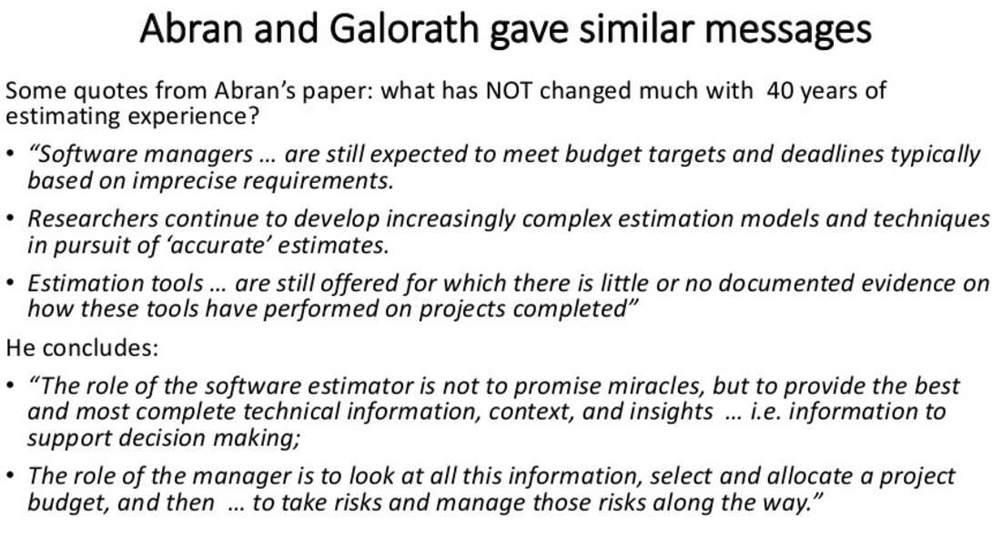

Slide 7
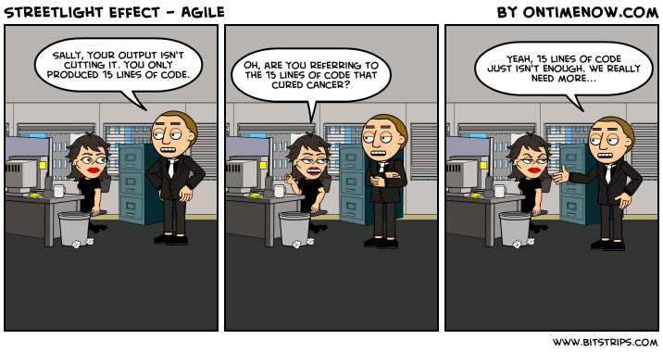

Slide 8
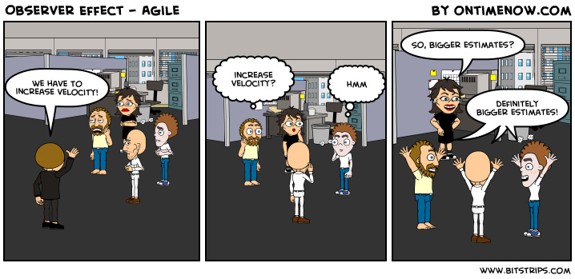

Slide 9
Working Agreements
Working Time
Break Time
Electronics
Corner Talk
Group Exercises
Participation
Our Values (for this project)
Focus
Communication
Respect
Openness
Courage
Share
Everybody
Notes:
Project Management Concepts
06/28/13
Version 3.1, 4/01 © 2003 by AstroWix
9

Slide 10
Workshop Objective
Understand Project & Project Boundaries
What to Estimate on Project?
Ranges of Estimates
Metrics, Benchmarking
Familiarity to Various Estimation Methods
Familiarity to Various Function Size Measurement Methods
Deep Dive Estimation using Function Point Analysis
Estimation using COSMIC FFP
Application of FSM in Development, Enhancement, Maintenance Projects. Agile and Traditional Project Management

Slide 11
Exclusion
In the interest of time and to learn maximum about software sizing.
Avoid deliberation on software costing and cost components, type of costs
Avoid deliberation on project scheduling techniques/ methodology/ tool
Avoid deliberation on various requirements documentation/ Business Analysis work
Avoid deliberation on various quality metrics and reporting formats.
However all these topics are related to software sizing so if absolute required we can discuss this consciously.

Slide 12
Agenda
Day 1
Introduction to Software Estimation
Understanding Elements of FPA of IFPUG
Estimating Transaction Function Types
Estimating Data Function Types
Day 2
Final Step of Size Estimation
Converting Size into Efforts
Converting efforts into Cost and Schedule
Day 3
Let us Count (A case study)- FPA
COSMIC FFP

Slide 13
Lets think little more about calculation, estimation…. What we calculate or estimate.

Slide 14
Calculation vs Estimate
Calculations are always correct and accurate unless your calculator has problem ☺
Estimates are guess… based on historical data or experience
If you cannot calculate (because of any reason) you should estimate.
If you cannot estimate you cannot calculate!
Quantity of bricks / cement/ steel in this building?
What is the distance between Delhi & Bangalore?
How many electron in all the carbon atom on this planet
How much money you earned last year?
How much value you delivered in last release of your product?
What was the average speed of your friend if he reached to you within 20 min
What was the size of software your department delivered in last 5 years?
Can you calculate the speed if you know the time but not the distance?
In your house renovation work…. can you calculate effort or money if you do not know the size of work?
In software how to know size?
Calculate or Estimate?

Slide 15
How do you estimate?
How will you know these numbers? Do you estimate this?
Number of brother and sister you have
Your age
Number of uncles and aunts you have
Total of your marks in secondary school exam

Slide 16
Some More Questions..
Do you estimate about past?
Do you estimate about present?
Do you estimate about future?
Why do we estimate?
In what circumstances you estimate?
What do you consider when you estimate?
What do you estimate?
When do you stop estimating?

Slide 17
Estimation…
Known is counted with 100% confidence
Unknown is estimated
When time is constraint to count then you estimate

Slide 18
Importance of Size of Work
To know the cost of house you need to know “How big is the house?”
To know the cost of item you need to know “What is the weight or length of an item?”
To know the cost of travel you need to know “What is the distance between two places?”
But to know the cost knowing “Size” is not enough.
You also need to know Quality of material to be used, Quality of output defined, Performance, Reliability, Portability etc.
You should also consider Inflation, Availability of Resources
Though there are many factors (like quality, complexity, skill) that affect the cost, schedule and effort for development, size is the primary factor that helps to estimate these.
Do you measure dimension of house at the time of final handover? If yes then you should also measure size of software at the time of final handover.

Slide 19
Work Size Estimate
Work size is independent of Productivity, Availability, Efficiency and Work Calendars
Knowing size of work is first step towards planning

Slide 20
Estimate
How much time is required to go from your city to your favorite past time vacation place?

Slide 21

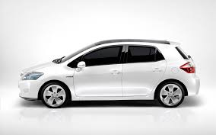
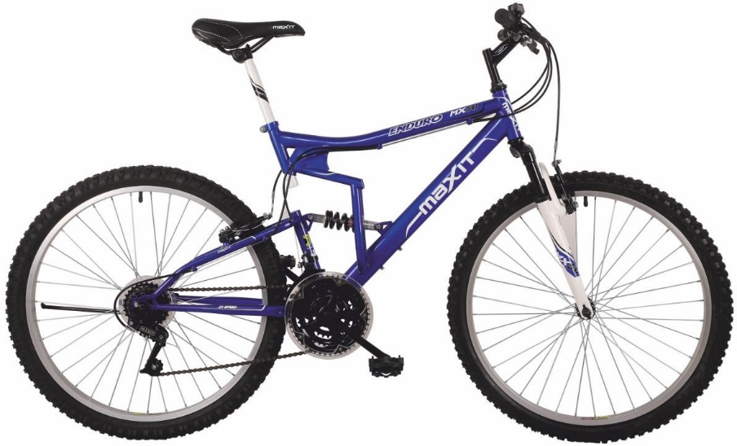

Duration Depends Upon - Mode

Slide 22





Duration Depends Upon- Roads

Slide 23
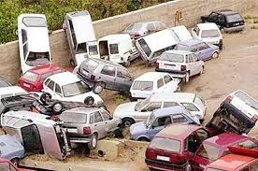
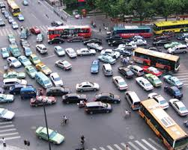
Duration Depends Upon- Traffic and Other People on Road

Slide 24



Duration Depends Upon- Driver

Slide 25

Duration Depends Upon- Distance

Slide 26
Project Duration Depends Upon
Environmental Factors (climate, politics, regulator, policies, willingness, project working time, resource availability, technology maturity)

Slide 27

How Many Candies in Jar?
What will you do to know the candies in jar without opening and physically counting them?
Factors affecting number are
Size of unseen candies
Distribution is equal in whole jar?
Is there anything else in jar
??

Slide 28
Realities of Estimation
Why we tend to underestimate?
Optimistic individuals and have a desire to please
Incomplete recall of previous experiences
Not generally familiar with the entire job to be required.
Murphy, of Murphy’s Law fame, will not work on this project.
Key estimating factors dramatically change estimates

Slide 29
Schedule is Influenced By
Historical Data
Intuition
PERT (3 Points)
Delphi
Your Experience
Productivity
Time of the year
Availability
Waiting
Team Configuration
Vacations
Holidays
Work Schedule
Elapsed Time
………………

Slide 30
Availability is Influenced by
A calendar has 365 days in a year.
Weekends
Holidays
Vacations
Sickness
Training
Conferences
Snow Days
Strikes
Floods
Terrorist Activities
Election
……………………….

Slide 31
Productivity in Influenced by
Availability is 8 Hours/day.
Bio-Breaks
Networking
Personal Phone Calls
Wasted Meeting Time
Interruptions
E-Mail, Voice, In-Box
Emotional and Physical Health Disturbances
Unrelated IMs & Chats
Travel, Elevator
Surfing, Games
………………………………….

Slide 32
So you estimate….
Work Size
Resources
Efforts
Duration
Elapsed Time
Scheduled Time
Project Budget
Project Cost Estimates
Cost Baseline
Contingency Reserve
Management Reserve

Slide 33
A Counting Game
You´ve found a shirt for US$ 97.00.
But, you have no money, so you´ve borrowed US$ 50.00 from your mother and US$ 50.00 from your father. So:
US$ 50.00 + US$ 50.00 = US$ 100.00
You´ve bought the shirt, and there is change of US$ 3.00.
You pay US$ 1.00 back to your father, US$ 1.00 to your mother and keep the other US$ 1.00 to you.
Now you owe US$ 49.00 to you mother and US$ 49.00 to your father.
US$ 49.00 + US$ 49.00 = US$ 98.00 + your US$ 1.00 = US$ 99.00
What about the other US$ 1.00?
This is accounting not counting!

Slide 34
Solution of Game

Slide 35
Estimate Time
How much time is required to produce these fruits in your farm house
OR How much time is required to collect these fruits from your farm house

Slide 36
Can a 4,000 Hour Project be of Smaller size than One of 1,000 Hours ?
If yes, then what are the reasons?

Slide 37
Estimation Real Purpose
Outsourcing Management
Benchmarking
Measurement and Estimating Programs
CMMI Assessments
Continuous Process Improvements
………..

Slide 38
How do you Estimate?
Take your best guess and multiply by two
Take the best guess, multiple by two and raise it to the next higher unit of time
Add 54%”(An algorithmically determined fudge factor)
Ask the boss which number they want
Take the remaining time until the deadline and multiply it by the number of people on the team
Look Up
What are the advantages?

Slide 39
Experienced based Estimation Techniques

Slide 40
Good Estimation Guidelines
Use ranges to know a confidence factor
Include basis of estimation (documented)
Perform at the appropriate level of detail
Should be performed by the person doing the work (experiential estimating)
Identify constraints and risks
Do not confuse between estimates of work and duration
Do not confuse between duration and project schedule
Considers experience and availability
Uses lessons learned at organization level
Never negotiates numbers without basis
Project Management Body of Knowledge 5th Edition

Slide 41
Estimation Types
Estimation at Initiation Stage
Rough order of Magnitude (ROM) – [-25% - +75%]
Budget Estimate [-10% - 25%]
Estimation when Project Work or Solution Approach is known
Bottom up or Definitive Estimates. When WBS & details are available [-5% - +10%]

Slide 42
Estimation Techniques
Expert Based Techniques
Analogous Estimation
Parametric Estimation
Bottom-up Estimation
Three point Estimation
Published Data Source
Delphi Estimation
Wideband Delphi Estimation
Planning Poker
Scientific Techniques
IFPUG Function Points (FP)
Use Case Points
Lines of Code
Cosmic Function Points

Slide 43
Analogous Estimation
Two years ago your brother got married and he spent INR 5 lacs. Now your close friend is planning to get married and he is asking how much it will take to get married if arrangement of similar type

Slide 44
Parametric Estimating
To make 500 SF flat you need 10000 bricks. How many bricks required to make a bungalow of 2500 SF
To travel 30 km it takes one hour how much time is required to travel 250 km

Slide 45
Bottom Up Estimating
 |  | Duration | Cost ('000) | Size
Implementation |  | 64 | 440 | 210
 | HR Operations | 20 | 100 | 80
 | Payroll | 18 | 120 | 60
 | Benefits Administration | 12 | 90 | 40
 | Employee Self Service | 14 | 130 | 30
Interfaces
 | HR
 | Payroll
 | Benefits Administration
Reporting
 | HR
 | Payroll
 | Benefits Administration
Testing
 | HR
 | Payroll
 | Benefits Administration
 | Employee Self Service
Launch
 | Training
 | Change Management

Slide 46
Three Point Estimation
Optimistic
Pessimistic
Most likely
Expected Value = (O + 4xM + P) /6
Standard Deviation = (P-O)/6

Slide 47
Published Estimating Data
If you do not have experts and experience around then from where you will get data to know
How much food is required to feed all the poor of your state?
How much paint is required to paint your complete duplex home?
How much time required to get business visa of Germany?
What is productivity in Core Java Technology?
How much time is required to convert 500 GB flat file database into Oracle DB?

Slide 48
Delphi Estimates
Only experts participates in estimation processes
Estimates are anonymous
Extreme estimates are discussed

Slide 49
Summary of Estimation
Understand project boundary
Estimate size of work first
Use multiple methods for estimating
Estimation is not a one time process
Consider productivity, availability, efficiency, calendar when determining time line
Estimation of duration, timeline, cost, resource is iterative process
Maintain a repository of estimates
Automate as much as possible
Establish metrics for your organization, department and project and keep refining benchmarks
Estimation is not only science but also art because lots of imagination, creative and sometime intuitive input involved

Slide 50
Function Point Analysis (FPA)

Slide 51
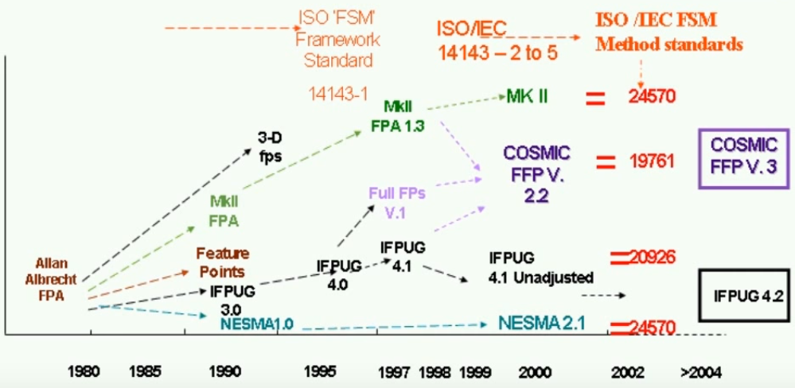
History of FSM

Slide 52
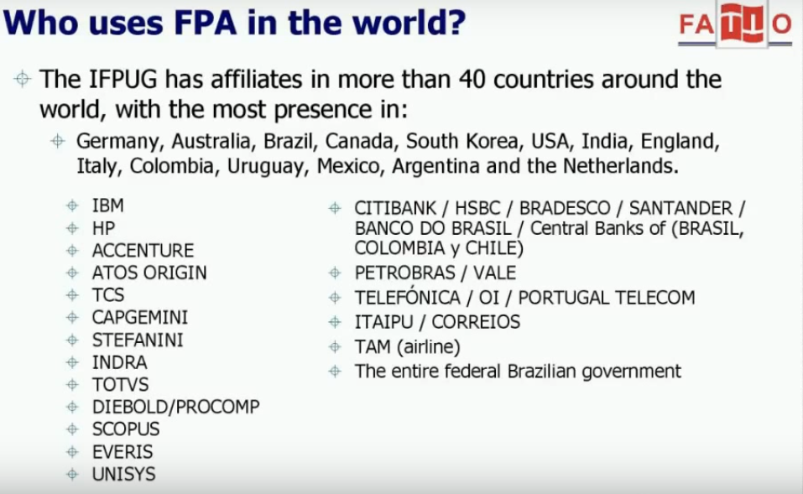

Slide 53

ISO Definitions
ISO/IEC/JTC1/SC7 Standard 14143-1(2004) Definitions:
Functional Size: A size of the software derived by quantifying the functional user requirements.
Functional Size Measurement (FSM): The process of measuring Functional Size.
FSM Method: A specific implementation of FSM defined by a set of rules, which conforms to the mandatory features o this part of ISO/IEC 14143

Slide 54
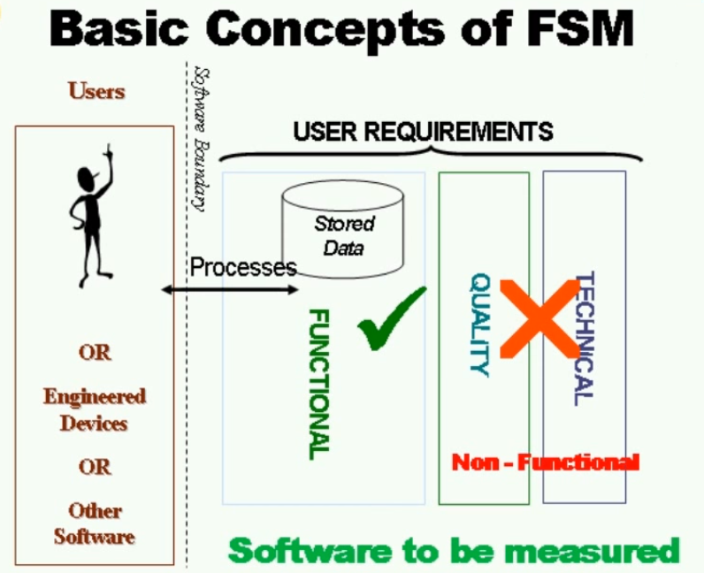

Slide 55
Functional Size Measurement
Measures Functional User Requirements
Excludes:
Physical or technical components
Quality features
Derived in terms understood by users of the software
Derived without reference to
Effort to develop or support
Methods used

Slide 56
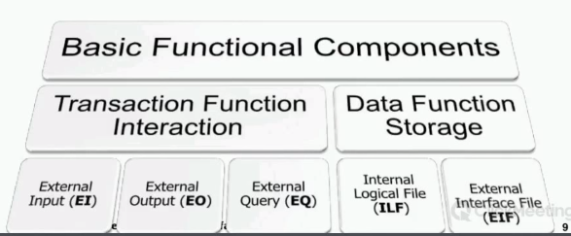

Slide 57
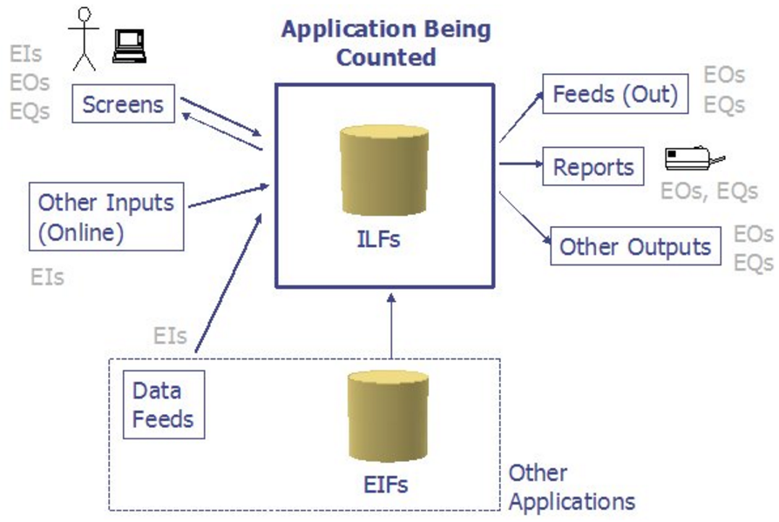
Functional Point Analysis- A Glance

Slide 58
FP Sizing is
Based on
Functional requirements as seen by the user. User functionalities
Screens
Reports
Data stores
Interfaces.
Not based on
Technical aspects of the development
Number of programs
Lines of code
Physical architecture etc.

Slide 59
FP is
FP is Repeatable and Reproducable
Provides functional and non-functional insights
Can be used in early development stages
Independent of implementation technology
Based on well defined rules so no technical skills required to count. Thus auditable.

Slide 60
Variants of Counting Methods
20+ variations for counting LOC
50+ variations for counting function points
20+ unreliable metrics such as story points, use-case points, cost per defect

Slide 61
Functional Size Measurement Variants
FPA of IFPUG based on current Counting Practice Manual (CPM) 4.3.1.
COSMIC-FFP of COSMIC: ISO/IEC 19761:2011 Software engineering.
FiSMA: ISO/IEC 29881:2008 Information technology - Software and systems engineering - FiSMA 1.1 functional size measurement method. Finnish function points
IFPUG: ISO/IEC 20926:2009 Software and systems engineering - Software measurement - IFPUG functional size measurement method.
Mark-II: ISO/IEC 20968:2002 Software engineering - Ml II Function Point Analysis - Counting Practices Manual
NESMA: ISO/IEC 24570:2005 Software engineering - NESMA function size measurement method version 2.1 - Definitions and counting guidelines for the application of Function Point Analysis. Netherlands function points

Slide 62
Constraints of LOC
LOC is issue when more than one languages are being used
Work of architects, designers, database administrators, quality assurance, technical writers, project managers, and many other occupations cannot be counted in LOC

Slide 63
Reality of Functional Sizing Methods (FSM)
For all current FSM methods two trained counters will achieve size figures of +/- 10 % if the user requirements are known and well specified.
if ten project managers from different business areas try to estimate project effort without a systematic approach, including FSM methods, the ratio between the smallest and biggest estimate is 1 to 6, the worst as high as 1 to 12.
Notes:
http://www.isbsg.org/ISBSGnew.nsf/WebPages/AC308EF2C87A3A2BCA25745F002CAE29

Slide 64
FPA : Key Terms used
Project Boundary
DET: Data Element Type
RET: Record Element Type
FTR: File Type Reference
Transactional Function Types
Internal Logical File (ILF)
External Interface File (EIF)
Data Function Types
External Input (EI)
External Output (EO)
External Query (EQ)
UFPC
AFPC
VAF
Degree of Influence

Slide 65
ILF Identification Rule
The group of data or control information is logical and user identifiable.
The group of data is maintained through an elementary process within the application boundary being counted.

Slide 66
ILF/EIF DET Counting Rules
Count a DET for each unique user recognizable, non-repeated field maintained in or retrieved from the ILF or EIF through the execution of an elementary process
When two applications maintain and/or reference the same ILF/EIF, but each maintains/references separate DETs, count only the DETs being used by each application to size the ILF/EIF.
Count a DET for each piece of data required by the user to establish a relationship with another ILF or EIF.

Slide 67
RET Counting Rules
Count a RET for each optional or mandatory subgroup of the ILF or EIF. (OR)
If there are no subgroups, count the ILF or EIF as one RET.

Slide 68
EIF Identification Rules
The group of data or control information is logical and user identifiable.
The group of data is referenced by, and external to, the application being counted.
The group of data is not maintained by the application being counted.
The group of data is maintained in an ILF of another application.

Slide 69
Elementary Process Counting Rules
The process is the smallest unit of activity that is meaningful to the user.
The process is self-contained and leaves the business of the application in a consistent state.

Slide 70
Step to FP Counting for Each Elementary Process
Step1: Identify the Elementary Process
Step2: Determine the Primary Intent, and classify
Step3: Validate against the EI/EQ/EO Counting Rules
Setp4: Determine Complexity (Count FTR & Count DET)
Setp5: Determine the Contribution

Slide 71
EI Counting Rules
The data or control information is received from outside the application boundary.
At least one ILF is maintained if the data entering the boundary is not control information that alters the behavior of the system.
For the identified process, one of the following three statements must apply:
Processing logic is unique from the processing logic performed by other external inputs for the application.
The set of data elements identified is different from the sets identified for other external inputs for the application.
The ILFs or EIFs referenced are different from the files referenced by other external inputs in theapplication.

Slide 72
FTR Counting Rules
Count an FTR for each ILF maintained.
Count an FTR for each ILF or EIF read during the processing of the external input.
Count only one FTR for each ILF that is both maintained and read.

Slide 73
DET Counting Rules for Elementary Process
Count one DET for each user recognizable, non-repeated field that enters or exits the application boundary and is required to complete the external input.
Do not count fields that are retrieved or derived by the system and stored on an ILF during the elementary process if the fields did not cross the application boundary.
Count one DET for the capability to send a system response message outside the application boundary to indicate an error occurred during processing, confirm that processing is complete or verify that processing should continue.
Count one DET for the ability to specify an action to be taken even if there are multiple methods for invoking the same logical process.

Slide 74
EO Counting Rules
The function sends data or control information external to the application boundary.
For the identified process, one of the following three statements must apply:
Processing logic is unique from the processing logic performed by other external outputs or external inquiries for the application.
The set of data elements identified is different from the sets identified for other external outputs and external inquiries in the application.
The ILFs or EIFs referenced are different from the files referenced by other external outputs and external inquiries in the application.
For the identified process, one of the following three statements must apply:
The processing logic of the elementary process contains at least one mathematical formula or calculation.
The processing logic of the elementary process maintains at least one ILF.
The processing logic of the elementary process creates derived data.

Slide 75
EQ Counting Rules
The function sends data or control information external to the application boundary.
For the identified process, one of the following three statements must apply:
Processing logic is unique from the processing logic performed by other external outputs or external inquiries for the application.
The set of data elements identified is different from the sets identified for other external outputs and external inquiries in the application.
The ILFs or EIFs referenced are different from the files referenced by other external outputs and external inquiries in the application.
The processing logic of the elementary process retrieves data or control information from an ILF or EIF.
The processing logic of the elementary process does not maintain an ILF.
The processing logic of the elementary process does not contain a mathematical formula or calculate
The processing logic of the elementary process does not create derived data.ion.

Slide 77
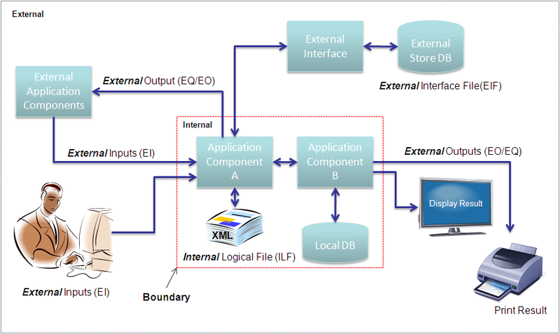
Project Boundary

Slide 78
DET: Data Element Type

Slide 79
RET: Record Element Type

Slide 80
FTR: File Type Reference

Slide 81
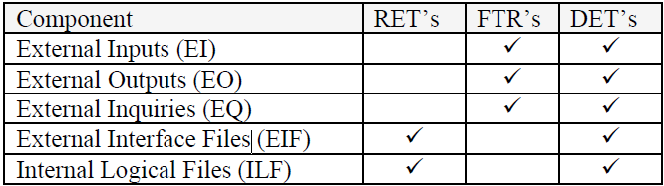
How to calculate?

Slide 82
Internal Logical Files (ILF) & External Interface Files (EIF)

Slide 83
Definition
An Internal Logical File (ILF) is a user identifiable group of logically related data or control information maintained within the boundary of the application

Slide 84
ILF Identification Rules
The group of data or control information is a logical, or user identifiable, group of data that fulfills specific user requirements.
The group of data is maintained within the application boundary.
The group of data is modified, or maintained, through an elementary process of the application.
The group of data identified has not been counted as an EIF for the application.

Slide 85
Hints for ILF/EIF Counting
Is the data a logical group that fulfills specific user requirements?
An application can use an ILF or EIF in multiple processes, but the ILF or EIF is counted only once.
Do not assume that one physical file equals one logical file when viewing data logically from the user perspective.
Although some storage technologies such as tables in a relational DBMS or a sequential flat file relate closely to ILFs or EIFs, do not assume that this always equals a one-to-one physical-logical relationship.
If a group of data was not counted as an ILF or EIF itself, count its data elements as DETs for the ILF or EIF which includes that group of data.
Do not assume all physical files must be counted or included as part of an ILF or EIF.

Slide 86
Hints for ILF/EIF Counting
Where is data maintained? Inside or outside the application boundary?
Look at the work flow.
In the process functional decomposition, identify where the user and other application interfaces occur.
Work through the process diagram to get hints.
Credit ILFs maintained by more than one application to each application at the time the application is counted.
An application can use an ILF or EIF multiple times, but you count the ILF or EIF only once.
Work through the process diagram to get hints.
Credit ILFs maintained by more than one application to each application at the time the application is counted.

Slide 87
Hints for ILF/EIF Counting Middleware
File structures that are used by an elementary process to analyze transaction data for the duration of the transaction is an ILF, even though the data itself is not retained.

Slide 88
Data Element Types
A data element type (DET) is a unique user recognizable, non-recursive field on the ILF or EIF.

Slide 89
DET Rules
Count a DET for each unique user recognizable, non recursive field on the ILF or EIF.
Count a DET for each piece of data in an ILF or EIF that exists because the user requires a relationship with another ILF to be maintained.
Count the following physical implementation techniques as a single DET for the entire group of fields.
Fields that appear more than once in an ILF or EIF because of technology or implementation techniques.
Repeating fields that are identical in format and exist to allow for multiple occurrences of a data value.

Slide 90
Record Element Types
A record element type (RET) is a user recognizable subgroup of data elements within an ILF or EIF.
Optional
Mandatory
Optional subgroups are those that the user has the option of using one or none of the subgroups during an elementary process that adds or creates an instance of the data.
Mandatory subgroups are those of which the user must use at least one of the subgroups.

Slide 91
Record Element Types: Example
In a Human Resources Application, information for an employee is added by entering some general information. In addition to the general information, the employee is a salaried or hourly employee (The user has determined that an employee must be either salaried or hourly). Either type can have information about dependents. For this example, there are three subgroups or RETs as shown below:
Salaried employee (mandatory); includes general information
Hourly employee (mandatory); includes general information
Dependent (optional)

Slide 92
RET Rules
Count an RET for each optional or mandatory subgroup of the ILF or EIF.
Or
If there are no subgroups, count the ILF or EIF as one RET.

Slide 93
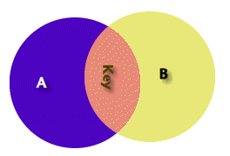
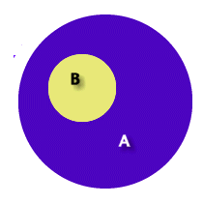
Example: RET
Some A are B – The first diagram represents two separate logical groups of data A and B (with key information between). This represents two internal logical files one RET each
All B are A – The second diagram represents one logical group of data A with two record types. B is a complete subset of A
Example – A singer gives voice to 50 different poems and creates a music album. Now if you have maintain records of CD and music in some system then you need one RET to manage Singer and his album. Second RET to manage music and related information.
Singer RET will have information (Singer, Producer, Label, Genre, Date)
Music RET will have information (Song Name, Length, Author)

Slide 94
ILF: Example1

Slide 95
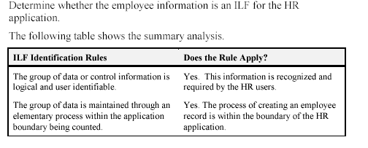
ILF: Example2

Slide 96
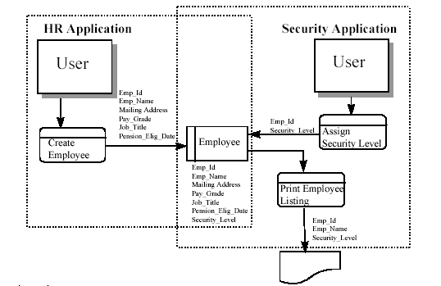
ILF: Example3

Slide 97
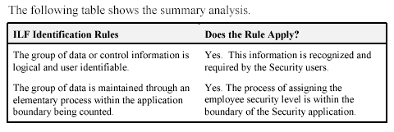
ILF: Example4
Determine whether the employee information is an ILF for the Security application.

Slide 98
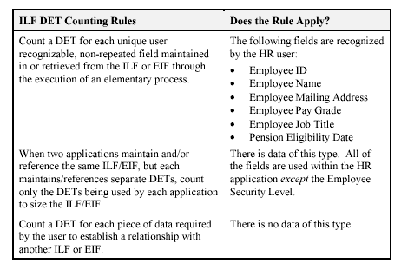
ILF: Example5
Counting DETs

Slide 99
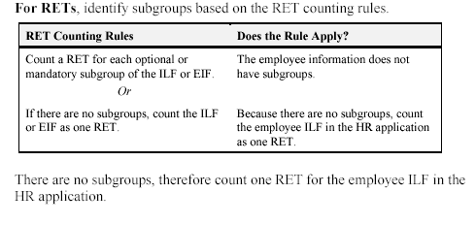
ILF: Example6
Counting RETs

Slide 100
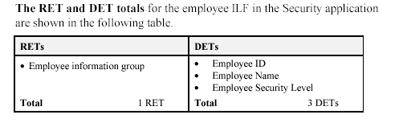
ILF: Example7
Counting DETs and RETs for Security Application

Slide 101
External Interface File

Slide 102
Definition
An external interface file (EIF) is a user identifiable group of logically related data or control information referenced by the application, but maintained within the boundary of another application. This means an EIF counted for an application must be an ILF in another application

Slide 103
EIF Identification Rules
The group of data is referenced by, and external to, the application being counted.
The group of data is not maintained by the application being counted.
The group of data is counted as an ILF for at least one other application.
The group of data identified has not been counted as an ILF for the application.

Slide 104
Estimation of GUI Elements

Slide 105
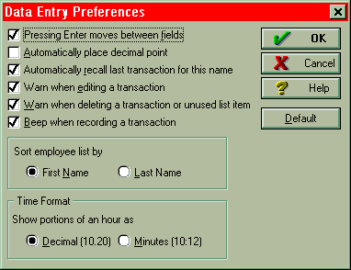
GUI Estimation: Example
Check Boxes – This may represent one data element or multiple data elements. The screen listed as Data Entry Preferences has numerous check boxes. In this case, each check box is considered a data element type (DET). Each check box is independent from other check boxes and provides different business functionality. The sort employee name and Time format are two additional data element types (DET’s) also.
How many DET’s..?
This particular screen has X data elements (Y DET’s and action key).

Slide 106
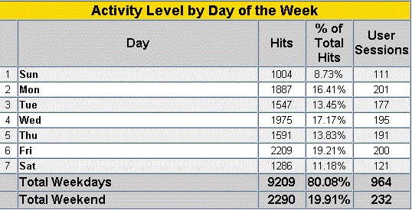
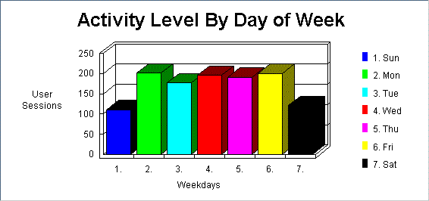
GUI Estimation: Example
There are 10 data elements in the following table
Days
Hits
% of Total Hits
User Sessions
Total Hits (weekday)
Total % (weekday)
Total User Sessions (weekday)
Total Hits (weekend)
Total % (weekend)
Total User Sessions (weekend)
One output

Slide 107
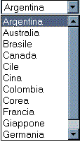
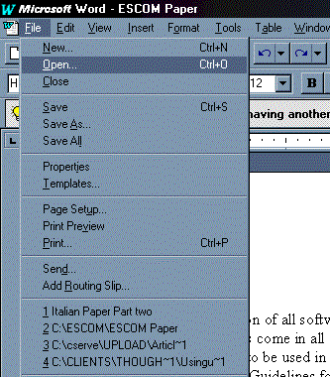
GUI Estimation: Example
Pick List – A dynamic pick list (drop down box) is an EQ if the country names are contained in an internal logical file or external interface file.
Menu – The menu displayed to the right is a dynamic menu. Word displays the last several files that have been opened. We can easily conclude that this information is being read from some type of internal file. Hence, the information is dynamic. The menu would be counted as an EQ. The real distinction is if a menu is dynamic or static. That is, are the contents of the screen or report dynamic (read from some file) or are they static.

Slide 108
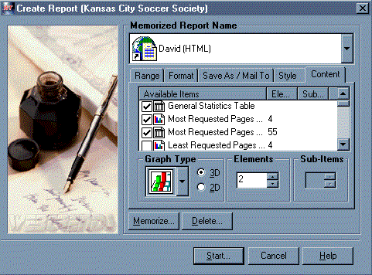
GUI Estimation: Example
It is common for GUI applications to have External Inputs preceded by serial inquiries. That is, a user may be able to select a customer name from a pick list (first EQ), the customer name is used as input for the second EQ which provides address, phone, zip and other contact information. From this point forward a user can add, change or delete the customer information (3 EI’s). In this case, this one screen would represent 2 EQ’s and 3 EI’s.
In the “Create Report” control screen, the user has the ability to select reports. This particular screen has several data elements types such as check box, graph type, dimensions, elements, sub-items and actions keys.
User can choice each report individually. In fact each report is as an object. The generated report is a combination of several reports (or objects). Each object has several attributes.

Slide 109
External Inputs

Slide 110
Definition
An external input (EI) processes data or control information that comes from outside the application's boundary. The external input itself is an elementary process. The processed data maintains one or more ILFs. The processed control information may or may not maintain an ILF.
OR
External Inputs (EI) is an elementary process in which data crosses the boundary from outside to inside. This data may come from a data input screen, electronically or another application. The data can be either control information or business information. If the data is business information it is used to maintain one or more internal logical files. If the data is control information it does not have to update an internal logical file.

Slide 111
Identification Rules
Input Data Counting Rules
The data is received from outside the application boundary.
The data in an ILF is maintained through an elementary process of the application.
The process is the smallest unit of activity that is meaningful to the end user in the business.
The process is self-contained and leaves the business of the application being counted in a consistent state.
For example, the user requirements to add an employee include setting up salary and dependent information. If all the employee information is not added, an employee has not yet been created. Adding some of the information alone leaves the business of adding an employee in an inconsistent state. If both the employee salary and dependent information is added, this unit of activity is completed and the business is left in a consistent state.

Slide 112
Identification Rules
Input Data Counting Rules
For the identified process, one of the following two rules must apply:
Processing logic is unique from other external inputs for the application.
The data elements identified are different from other external inputs for the application.

Slide 113
Identification Rules
Control Information Processing Rules
The control information is received from outside the application boundary.
The information is specified by the user to ensure compliance with business function requirements.
For the identified process, one of the following two rules must apply:
- Processing logic is unique from other external inputs for the application.
- The data elements identified are different from other external inputs for the application.
The processed control information may or may not maintain an ILF

Slide 114
File Types Referenced
Definition
A file type referenced is
An internal logical file read or maintained by a function type
An external interface file read by a function type.

Slide 115
FTR Rules
Count a file type referenced for each internal logical file (ILF) maintained.
Count a file type referenced for each internal logical file (ILF) or external interface file (EIF) read during the processing of the external input.
Count only one FTR for each ILF that is both maintained and read by the external input.

Slide 116
Data Element Types
A data element type (DET) is a unique user recognizable, non-recursive field maintained on the Internal Logical File by the External Input

Slide 117
DET Counting Rules
Count a DET for each unique user recognizable, non-recursive field maintained on an ILF by an external input.
Count a DET for each field that is not entered by the user, but through an external input, is maintained on an internal logical file.
Count the following physical implementation techniques as a single DET for the entire group of fields:
A logical field that is stored physically as multiple fields, but is required by the user as a single piece of information.
For example, an account number or date physically stored in multiple fields, but required by the user as a single piece of information, is counted as one DET.

Slide 118
DET Counting Rules: GUI
Radio Buttons – One DET is counted for all the radio buttons contained in the frame.
Check Boxes – Each check box, within a frame, that can be selected should be treated as a data element.
Command Buttons – According to IFPUG counting rules each command button would be counted as a data element for the action it invokes.
Display of Graphical Images or Icons – A display of a graphical image or schematic is treated as a single DET.
Sound Bytes - Sound byte is one DET.
Photographic Images – A photographic image is one DET.
Messages – Error message and Confirmation message are treated as a one DET each for the appropriate transaction.

Slide 119
DET Counting Rules: GUI
Command Buttons – Command Buttons are one DET each. Command buttons may specify an add, change, delete or inquire action. For example, a simple application to track Distributors could have fields for Distributor Name, Address, City, State, Zip, Phone Number, and Fax Number. This would represent seven data elements (7 DET’s) and the add command button would represent the 8th data element. In short, the add external input represents a one external input with eight data elements, the change external input represents another external input with eight data elements (7 fields plus the change command button), and the delete external input represents the last external input with eight data elements (7 fields plus the delete command button).
Graphic Images are one DET
Sound Bytes – This represents one data element. The number of notes played is simply recursive information. If the length of the sound byte increases, then the data element remains one. If it is played for two seconds or four seconds, then this is still one data element.

Slide 120
DET Counting Rules: GUI
In a GUI or OO environment it is common for information to move from one window to the next. The actual movement of data is not considered an external input because it has not crossed the application boundary (outside to inside) and does not maintain an ILF.

Slide 121
DET Counting Rules. GUI
Messages
Error Messages / Confirmation Messages – It indicates that a process will be or has been completed. A message, “Zip code is required” would be an example of an error message. A message, “Are you sure you want to delete the customer?” is an example of a confirmation message. Neither of these type of messages are treated as a unique External Output, but they are treated as data elements for the appropriate transaction. Each is one DET
Notification Messages – It is the basis of processing and a conclusion being drawn. For example, while withdrawing from an ATM machine more money than you have in your account. You may receive the message, “You have insufficient funds to cover this transaction.” This is the result of information being read from a file and a conclusion being drawn. A notification message is treated as an EO.
Notification Messages may be the result of processing and the actual processing or derived data my not be seen. If a message is created to be sent to a pager (beeper) at a given time. This is much like an alarm. The pager message has one data element the text message.

Slide 122
DET Counting Rules: GUI
External Inputs
In GUI external inputs are preceded by serial inquiries
Each Add, Delete or Change function would be one External Input
Radio Buttons in a group are treated as one DET Within a group of radio buttons the user has the option of selecting only one radio button at a time, so only one data element type is counted for all the radio buttons contained in the entire frame.

Slide 123
DET Counting Rules: Examples
Example: An account number that is stored in multiple fields is counted as one DET.
Example: A before or after image for a group of 10 fields maintained for audit purposes would count as one DET for the before image (all 10 fields) and as one DET for the after image (all 10 fields) for a total of 2 DETs.
Example: The result(s) of a calculation from an elementary process, such as calculated sales tax value for a customer order is counted as one DET on the customer order ILF.
Example: Accessing the price of an item which is saved to a billing file or fields such as a time stamp if required by the user(s) are counted as DETs.

Slide 124
DET Counting Rules: Examples
Example: If an employee number appears twice in an ILF or EIF as (1) the key of the employee record and (2) a foreign key in the dependent record, count the DET only once.
Example: Within an ILF or EIF, count one DET for the 12 Monthly Budget Amount fields. Count one additional field to identify the applicable month.
When two applications maintain and/or reference the same ILF/EIF, but each maintains/references separate DETs, count only the DETs being used by each application to size the ILF/EIF. For example, Application A may specifically identify and use an address as: street address, city, state and zip code. Application B may see the address as one block of data without regard to individual components. Application A would count four DETs; Application B would count one DET.

Slide 125
DET Counting Rules: Examples
Example: Application X maintains and/or references an ILF that contains SSN, Name, Street Name, Mail Stop, City, State, and Zip. Application Z maintains and/or references the Name, City, and State. Application X would count seven DETs; Application Z would count three DETs.
Count a DET for each piece of data required by the user to establish a relationship with another ILF or EIF. For example, in an HR application, an employee's information is maintained on an ILF. The employee’s job name is included as part of the employee's information. This DET is counted because it is required to relate an employee to a job that exists in the organization. This type of data element is referred to as a foreign key.
Example: In an object oriented (OO) application, user requires an association between object classes, which have been identified as separate ILFs. Location name is a DET in the Location EIF. The location name is required when processing employee information; consequently, it is also counted as a DET within the Employee ILF.

Slide 126
When to Count Single DETs ?
Fields that appear more than once in an internal logical file because of technology or implementation techniques.
Fields that indicate an error occurred during processing or confirm that processing is complete.
Example: Error Message Fields.
Count a single DET for the capability to specify the action to be taken by the external input.
Example: count as one DET command lines or function/action (PF) keys that provide the capability to specify the action to be taken by the external input. Count this as one additional DET per external input.

Slide 127
DET Counting Rules- Real Time System
Real time and embedded systems – The time of diagnostics, hardware state during diagnostics, temperature, voltage etc. would all be examples of one DET each.
Operator Controls, Volume Controls, Sensor Readings, Radio Frequencies, Standards and Limit Settings (Alarms Settings etc.) would be counted as one DET each.

Slide 128
Hints for EI Counting
Is data received from outside the application boundary?
- Look at the work flow.
- Identify where the user and other application interfaces occur in the process functional decomposition.
Is the process the smallest unit of activity from the user perspective?
- Look at the different forms used.
- Review the ILFs to identify how the user groups the information.
Identify where the user and other application interfaces occur in the process functional decomposition.
- Look at what happened in the manual system.
- Note that one physical input or transaction file or screen can, when viewed logically, correspond to a number of EIs.
- Note that two or more physical input or transaction files or screens can correspond to one EI if the processing logic is identical.

Slide 129
Hints for EI Counting
Is the process self-contained and does it leave the business in a consistent state?
- Review external outputs and external inquiries to understand how the user works with the information.
- Work through the process diagram to get hints.
- Look at what happened in the manual system.
- Check for consistency with other decisions

Slide 130
Hints for EI Counting
Is the processing logic unique from other EIs?
- Identify batch inputs based on the processing logic required.
Are the data elements different from those for other EIs?
- If the data elements appear to be a subset of the data elements of another external input, be sure two elementary processes are required by the user—one for the main data elements and one for the subsets.

Slide 131
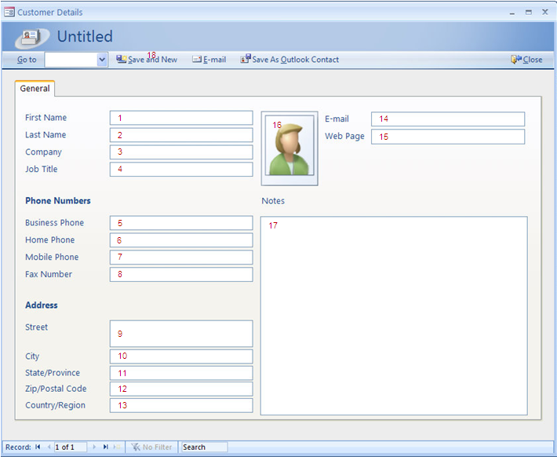

Slide 132
External Outputs

Slide 133
Definition
An external output (EO) is an elementary process that generates data or control information sent outside the application's boundary.
OR
External Outputs (EO) is an elementary process in which derived data passes across the boundary from inside to outside. The data creates reports or output files sent to other applications. These reports and files are created from one or more internal logical files and external interface file .
Derived Data is data that is processed beyond direct retrieval and editing of information from internal logical files or external interface files. Derived data is the result of algorithms, and/or calculations. Derived data occurs when one or more data elements are combined with a formula to generate or derive an additional data element(s).

Slide 134
Identification Rules
The process sends data or control information external to the application's boundary.
The data or control information is sent through an elementary process of the application.
The process is the smallest unit of activity that is meaningful to the end user in the business.
The process is self-contained and leaves the business of the application being counted in a consistent state.
For the identified process, one of the following must apply:
Processing logic is unique from other external outputs for the application.
The identified data elements are different from other external outputs for the application.

Slide 135
FTR for Outputs
Definition
A file type referenced is a file read when the external output is processed
Rules
Count a file type referenced for each internal logical file (ILF) or external interface file (EIF) read during the processing of the external output.

Slide 136
DETs for Outputs
Definition
A data element type is a user recognizable, non-recursive field that appears on the external output
Rules
Count a DET for each user recognizable, non-recursive field that appears on the external output.
Do not count literal as DETs.
Do not count paging variables or system-generated stamps.

Slide 137
Counting Outputs
When to Count Single DETs ?
A logical field that is stored physically as multiple fields, but is required by the user as a single piece of information.
Each type of label and each type of numerical equivalent in a graphical output.
Text information that may be a single word, sentence, or phrase.
For example, a message is included on a report to indicate why a transaction to add a job could not be completed successfully.

Slide 138
DET Counting Rules: GUI
External Outputs
Textual, graphical or electronic information
Each type of report to be treated as external outputs.
External Inquiries
Serial Inquiries to be counted separately
EQs do not contain derived data
for e.g.. customer is selective from customer list which in turn is used to extract other customer details

Slide 139
Hints for EO Counting
Is data sent outside the application boundary?
- Look at the work flow.
- Identify where the user and other application interfaces occur in the process functional decomposition.
Is the process self-contained and does it leave the business in a consistent state?
- Review external inputs and external inquiries to get an overall view of how the user works with the information.
- Work through the process diagram to get hints.
- Look at what happened in the manual system.

Slide 140
Hints for EO Counting
Is the process the smallest unit of activity from the user perspective?
- Look at the different forms used.
- Review the ILFs to identify how the user groups the information.
Identify where the user and other application interfaces occur in the process functional decomposition.
Look at what happened in the manual system.
Remember that one physical report, screen, or batch output file can, when viewed logically, correspond to a number of EOs.
Remember that two or more physical reports, screens, or batch output files can correspond to one EO if the processing logic is identical.

Slide 141
Hints for EO Counting
Is the processing logic unique from other EOs?
- Identify output based on the processing logic required.
- Remember that resorting or rearranging a set of data does not make processing logic unique.
Are the data elements different from other EOs?
- If the data elements appear to be a subset of the data element of another EO, be sure two elementary processes are required by the user—one for the main data element and one for the subsets.

Slide 142
External Query

Slide 143
Definition
An external inquiry (EQ) is an elementary process made up of an input-output combination that results in data retrieval. The output side contains no derived data. No internal logical file (ILF) is maintained during processing.
OR
External Inquiry (EQ) is an elementary process with both input and output components that result in data retrieval from one or more internal logical files and external interface files. This information is sent outside the application boundary. The input process does not update any Internal Logical Files and the output side does not contain derived data.

Slide 144
Identification Rules
An input request enters the application boundary.
Output results exit the application boundary.
Data is retrieved.
The retrieved data does not contain derived data.
The input request and output results together make up a process that is the smallest unit of activity that is meaningful to the end user in the business.

Slide 145
Identification Rules
The elementary process is self-contained and leaves the business of the application being counted consistent.
The processing does not update an ILF.
For the identified process, one of the following two rules must apply:
The processing logic on the input or output side is unique from other external inquiries in the application.
The data elements making up the input or output side are different from other external inquiries in the application.

Slide 146
FTR for Outputs
Definition
A file type referenced is a file read when the external inquiry is processed
Rules
For each input/output side of the external inquiry, count a file type referenced for each internal logical file and external interface file read during the processing of the external inquiry.

Slide 147
DETs for Outputs
Definition
A data element type is a user recognizable, non-recursive field that appears in the external inquiry.
Rules
Count a DET for each user recognizable, non-recursive field that appears on the input/output side of external inquiry.
Count a DET for each field that specifies the data selection criteria.
Do not count literal as DETs for output queries
Do not count paging variables or system-generated stamps for output queries.

Slide 148
Counting Inquiries
When to Count Single DETs ?
Fields indicating that an error has occurred while processing the input DETs or confirming that processing is complete.
Fields that provide the capability to specify the external inquiry is to be executed
A logical field that is stored physically as multiple fields, but is required by the user as a single piece of information.
Fields that, because of technology or implementation techniques, appear more than once in an internal logical file.

Slide 149
Hints for EQ Counting
Is data directly retrieved from an ILF or EIF?
- Look at the work flow.
- Identify where the user and other application interfaces occur in the process functional decomposition.
Is the process self-contained and does it leave the business in a consistent state?
- Review external inputs and external inquiries to get an overall view of how the user works with the information.
- Work through the process diagram to get hints.

Slide 150
Hints for EQ Counting
Is the process the smallest unit of activity from the user perspective?
- Look at the different forms used.
- Review the ILFs to identify how the user groups the information.
Identify where the user and other application interfaces occur in the process functional decomposition.
Look at what happened in the manual system.
Remember that one physical report, screen, or batch output file can, when viewed logically, correspond to a number of EQs.
Remember that two or more physical reports, screens, or batch output files can correspond to one EQ if the processing logic is identical.

Slide 151
Hints for EQ Counting
Is processing logic unique from other EQs?
- Look for derived data to distinguish inquiries from outputs.
- Remember that resorting or rearranging a set of data does not make processing logic unique.
Are the data elements different from other EQs?
If the data elements appear to be a subset of the data elements of another external inquiry, be sure two elementary processes are required by the user—one for the main data elements and one for the subset.

Slide 152
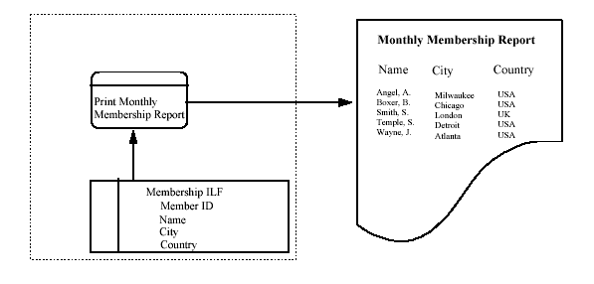
EQ Counting : Example1

Slide 153
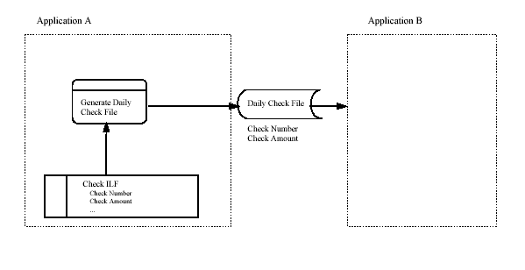
EQ Counting: Example2

Slide 154
Value Adjustment Factor

Slide 155
General System Characteristics
Data communications
Distributed data processing
Performance
Heavily used configuration
Transaction rate
Online data entry
End-user efficiency
Online update
Complex processing
Reusability
Installation ease
Operational ease
Multiple sites
Facilitate change

Slide 156
Degrees of Influence
0 - Not present, or no influence
1 - Incidental influence
2 - Moderate influence
3 - Average influence
4 - Significant influence
5 - Strong influence throughout

Slide 157
Value Adjustment Factor (VAF)
VAF = SUM(GSC Weightage)
AFP = UAFP * VAF

Slide 158
Summary Table: FP Counting
Input Complexity Matrix (EI)
FTRs | 1-4 DETs | 5-15 DETs | 16+DETs |  |  | EI/EQ
0-1 | Low | Low | Average |  | Low | 3
2 | Low | Average | High |  | Average | 4
3+ | Average | High | High |  | High | 6
Output Complexity Matrix (EO/EQ)
FTRs | 1-4 DETs | 5-15 DETs | 16+DETs |  |  | EO
0-1 | Low | Low | Average |  | Low | 4
2-3 | Low | Average | High |  | Average | 5
4+ | Average | High | High |  | High | 7
File Complexity Matrix (ILF, EIF)
RETs | 1-19 DETs | 20-50 DETs | 51+ DETs |  |  | ILF | EIF
1 | Low | Low | Average |  | Low | 7 | 5
2-4 | Low | Average | High |  | Average | 10 | 7
5+ | Average | High | High |  | High | 15 | 10

Slide 159
Thumb Rule of FP Elements Identification
Data Functions
ILF : Validate any CRUD operation performed on a database, table, file or component including in memory caching within the boundary of the application.
EIF: Any operation invoked through a web services interface, or remote application interface through some middle-ware technology or remote access through various protocols. The data is stored outside the boundary in another system typically in another application server, content management system or file server but referenced and used by the application concerned.

Slide 160
Thumb Rule of FP Elements Identification
Transaction Functions
EI : User providing data in an online application form, selecting options, choices, inputs text, uploads files or feeds data into the system. An external application sends data to be stored/processed or both. Receive data from external sources as stream feeds at intervals. Receive a device event such as alarms or triggers with relevant data to be processed.
EQ
Data that is fetched from the database displayed as a result of some user action.
Data which may sent to external devices such as printers or other devices.
Data which is sent to other external applications outside the application boundary.
EO
Data that is fetched from the database displayed as a result of some user action.
Data which may sent to external devices such as printers or other devices.
Data which is sent to other external applications outside the application boundary.
The main difference of an EO from an EQ is that it may contain some mathematical equation, calculation of sum, average, count or other manipulation of data, or may create additional derived fields such as totals, subtotals, calculation of final cost and may also update the ILF to reflect the computed sum.

Slide 161
FP Calculation : Thumb Rule

Slide 162
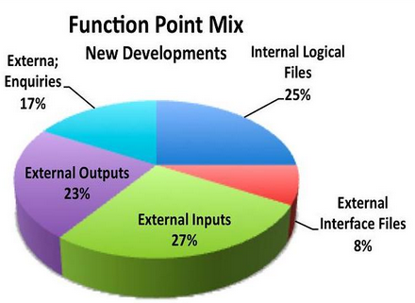
Thumb Rule for Early Prediction
Early Prediction of Functional Size from a Logical Data Model
If an application has 40 ILF
ISBSG Repository shows that most ILF are low to medium. Thus complexity attributed is 9 FP
Total ILF = 40 x 9 = 360 FP
Total App size = 360 x 4 (25%) = 1440 FP
Many organization has come up 1 ILF = 30 Something. It varies between 31-35 FP.
Notes:
http://www.isbsg.org/isbsgnew.nsf/WebPages/D9071CA94B167BA8CA257482003A36DF

Slide 163
Thumb Rule for Early Prediction
The Rule of the "Thirties" - Use Cases There is a rule of thumb of one Use Case being approximately 35 function points. Obviously this is a very rough approximation as Use Case sizes can vary significantly.
Use Case Points to Function Points You can approximate function points from Use Case Points by dividing your Use Case Points by 1.25.

Slide 164
Thumb Rule for Early Prediction
Functional Size and Duration Relationships
Project Class | Equation (Duration=) | Example (Duration) | Project Duration
3GL projects: | 0.971 * FP ^ 0.351 | Duration = 0.971* 1440^ 0.351 | 12.47 months
4GL projects: | 0.622 * FP ^ 0.405 | Duration = 0.622 * 1440 ^0.405 | 11.83 months
Application Generator | 1.472 * FP ^ 0.280 | Duration = 1.472 * 1440 ^0.280 | 11.28 months

Slide 165
Thumb Rule for Early Prediction
Work Effort and Duration Relationship
Efforts (Man-hours) = (Duration / .38)^(1/.37)
*Duration in Calendar Months
Efforts = (11.83 /.38) ^ (1/.37) = 10850 Man-hours

Slide 166
Function Point Calculation Steps
Identify and count ILF, EIF, EI , EO and EQ
For each ILF and EIF, identify the number of RETs and the number of DETs
For each EI, EO and EQ, identify the number of FTRs and DETs
Using the complexity matrices, count the number of low, average and high EI, EO, EQ, ILF and EIF items.
Compute the total unadjusted function points
Determine the values of the fourteen general system characteristics
Sum the total characteristics
Determine the total function points with the Total Function Point Formula
[0.65 + (.01 x total of General System Characteristics)] x [Unadjusted Function Point Count] = Total function points

Slide 167
Efforts , Cost & Duration Calculation

Slide 168
Use Case Estimation

Slide 169
COSMIC-FFP

Slide 170
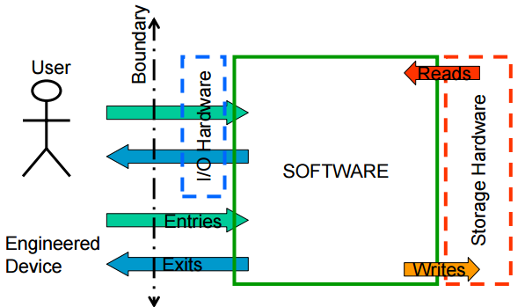
COSMIC-FFP

Slide 171
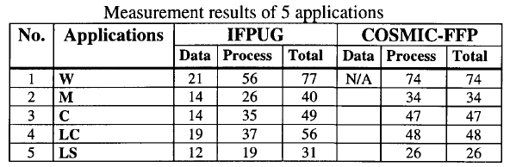
IFPUG vs COSMIC

Slide 172
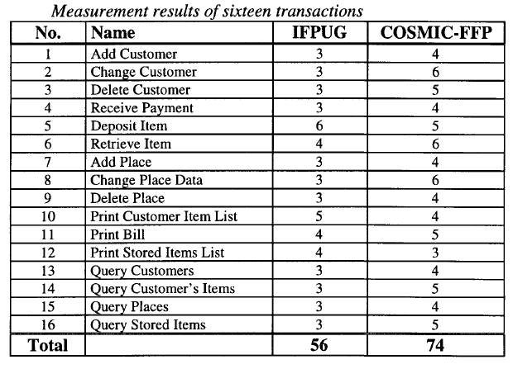
IFPUG vs COSMIC

Slide 173
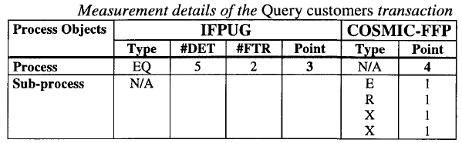
IFPUG vs COSMIC

Slide 174
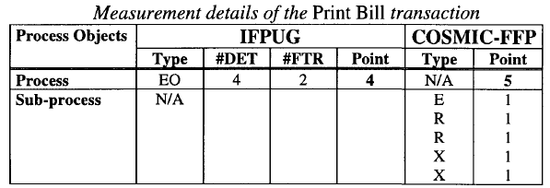
IFPUG vs COSMIC

Slide 175
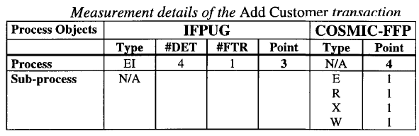
IFPUG vs COSMIC

Slide 176
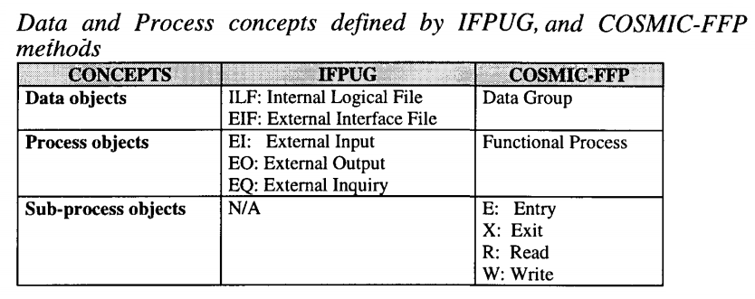

Slide 177
15 Types of Errors in Function Size Measurements
Error Category | Name
EC01 | Duplicated Functional Process (FP)
EC02 | Lack of list FP before Update FP
EC03 | Lack of List FP before Delete FP
EC04 | Lack of Retrieve FP before Update FP
EC05 | Lack of Data Movement (DM) type Write (W) in Add, Delete and Update FPs
EC06 | Redundant DM type W in list FPs
EC07 | Multiple Occurrences of the same DM with the same FP
EC08 | Each FP should be composed of at least 2 DMs
EC09 | Each FP should containt at least 1 Write (W)/ Exit (X) DM
EC10 | Each FP should contain at least 1 Entry (E) DM
EC11 | List FP Might be included in Update/Delete FP
EC12 | Create/Delete/Update Operations might be combined
EC13 | Data Group (DG) Duplication
EC14 | User Inteface Components and System Users are considered as DG/Object of Interest (OOI)
EC15 | OOI are named wrong

Slide 178
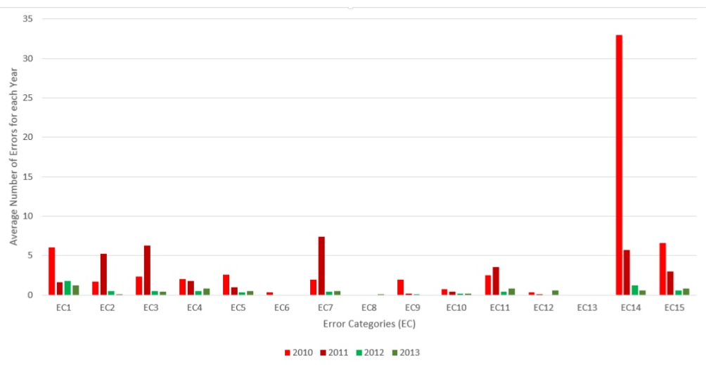
Error Categories Graphs

Slide 179
Recap
Concepts of Estimation
Earned Value Management
Forecasting
Metrics
Estimation Techniques
Function Point Analysis (FPA)
FP Calculation: Thumb Rules
Efforts , Cost & Duration Calculation
Use Case Estimation
Recap Workshop Learnings

Slide 180
References
http://www.isbsg.org/
ISBSF: International Software Benchmarking Standards Group. The Global and Independent Source of Data and Analysis for the IT Industry
http://www.ifpug.org/
International Function Point User Group
http://pmi.org/
Project Management Institute
http://www.softwaretestingclass.com/software-estimation-techniques/
Software Estimation Techniques - Common Test Estimation Techniques used in SDLC
http://www.projectmanagementguru.com/estimating.html
Project Management Estimating Tools & Techniques
Function Point Counting Practices Manual Version 4.3
Project Management Body of Knowledge 5th Edition

Slide 181

Hari P Thapliyal,
PMP, PMI-ACP, MCITP, PRINCE2 Practitioner, CSM, MBA, MCA, CIC, PGDFM
PMO Architect & Project Management Evangelist
Profile: http://in.linkedin.com/in/harithapliyal
For content related queries please contact me via
hari.Prasad@vedavit-ps.com
This document is proprietary and confidential. It remains the property of Vedavit Project Solutions at all times. No part of this document may be used, reproduced, or transmitted in any form or by any means electronic, including photocopying and recording, for any purpose without express consent of Vedavit Project Solutions.

